Slide 1
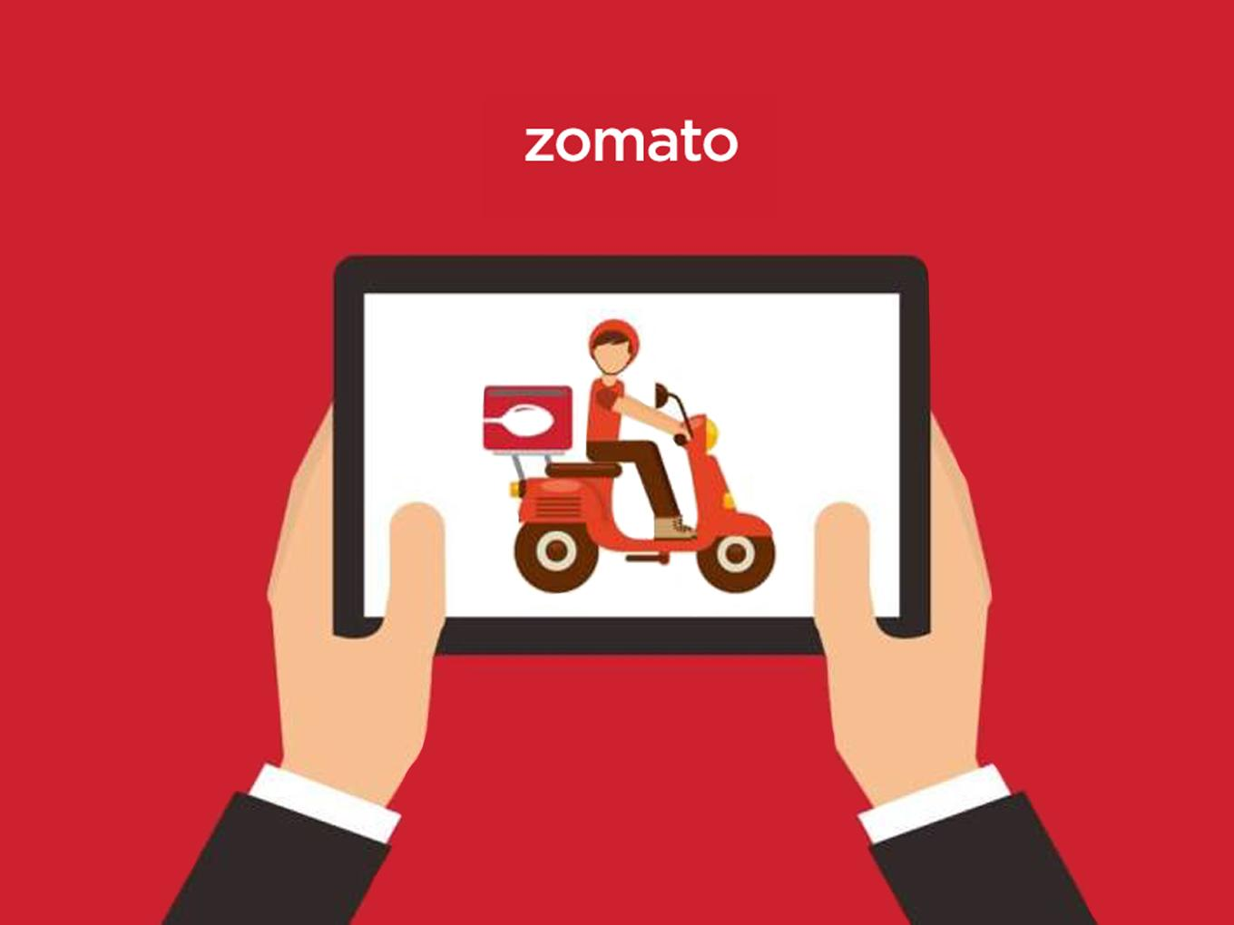
Zomato Restaurant Analysis
Ms. Achal Zalke
16/04/2024

Slide 2


Introduction
About Zomato
How Zomato works
Zomato was established in July 2008 by Deepinder Goyal and Pankaj Chaddah. The name "Zomato" is derived from the word "tomato." The founders wanted a name that was catchy and easy to remember, and they felt that incorporating a familiar word like "tomato" into the name would make it more memorable. They eventually settled on "Zomato" because it sounded quirky and fun, while also being unique.
Zomato is a food delivery and restaurant discovery platform. Users browse nearby restaurants, view menus, and place orders for delivery or pickup. Orders are tracked, payments secured, and feedback welcomed. Zomato partners with restaurants and utilizes delivery executives for efficient service, prioritizing convenience and quality.

Slide 3

Objectives :
Convenience : Zomato aims to provide a convenient platform for users to discover new restaurants, browse menus, place orders for delivery or takeaway, and make reservations.
Variety : Offering a wide variety of restaurant options, Zomato aims to cater to diverse culinary preferences and dietary requirements, ensuring that users can find something they love to eat.
Accessibility : Zomato strives to make food delivery and restaurant discovery accessible to people across different locations, including urban and rural areas.
Quality : Ensuring the quality of both food and service is a key objective for Zomato. This involves partnering with reputable restaurants and monitoring customer feedback to maintain high standards.
Innovation : Zomato continually seeks to innovate and improve its platform, introducing new features and services to enhance the user experience.
Business Growth: As a company, Zomato aims to grow its user base, expand into new markets, and increase its revenue streams through advertising, subscription services, and partnerships.

Slide 4
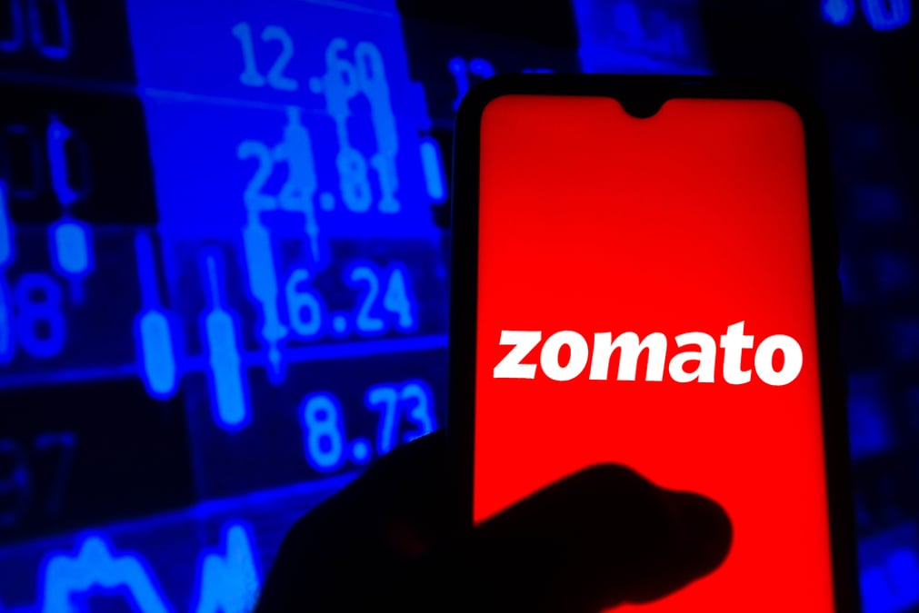
Data overview:
Total number of restaurants: 9551 restaurants across various countries.
Number of countries: There are 9551 restaurants across 15 countries.
Geographical coverage: services reach 141 cities across 15 countries showing international wide penetration.
Data cleaning and preprocessing:
Address missing value cuisines to enhance data integrity.
Change the date_key opening in the date format for accurate data and check for blanks in the data and changed it.
This dataset allows for an in- depth understanding of Zomato's market presence and operational scope.
High-quality data is crucial for analyzing restaurant rating, restaurant behavior, and restaurants performance.
Insights from user demographics and order volumes are key to optimizing marketing strategies and expanding food offerings.

Slide 5




Analytical Approach And Tools:
Data cleaning: Utilize function like clean proper clean to remove duplicates to ensure data accuracy.
Data enrichment: enhance the data set with additional variable using VLOOKUP function.
Descriptive analysis: use pivot table for summarizing key matrix and identifying restaurants across different countries and cities.
Statistical analysis: conducted analysis using COUNT, AVERAGE and ARRAY formula , etc.
Restaurant analysis, cuisine analysis and competitive analysis.
Visualization: created dynamic charts and dashboard for data representation , enabling interactive data exploration.

Slide 6
Analysis of Objective Questions:
TOTAL NUMBER OF RESTAURANTS OPENED EACH YEAR
Years | No of Restaurants
2010 | 1080
2011 | 1098
2012 | 1022
2013 | 1061
2014 | 1051
2015 | 1024
2016 | 1027
2017 | 1086
2018 | 1102
Grand Total | 9551
Total there are 9551 restaurants across each countries according to a data .
India has most number of restaurants i.e 8652.
These are the number of restaurants opened each year
According to the table in 2018 we have the most no. of restaurants i.e 1102.

Slide 7
TOTAL NUMBER OF RESTAURANTS
Country | No of restaurants
Australia | 24
Brazil | 60
Canada | 4
India | 8652
Indonesia | 21
New Zealand | 40
Philippines | 22
Qatar | 20
Singapore | 20
South Africa | 60
Sri Lanka | 20
Turkey | 34
United Arab Emirates | 60
United Kingdom | 80
United States of America | 434
Grand Total | 9551
No of Restaurants in INDIA with price range 4
388
According to my suggestion Canada, Indonesia, Philippines, Qatar, Singapore and Sri Lanka are the countries were number of restaurants are less so the competition will be less therefore we should open restaurants
There are 388 restaurants in India with price range 4
There are 26 columns in the raw data.

Slide 8
Insights from Subjective Questions
Total there are 9551 restaurants including each country.
We should open new restaurants in countries where competition is less.
According to the analysis Sri Lanka, Singapore, Qatar, Indonesia, Philippines, and Canada are the Countries where the number of restaurants is less as compared to other countries.
Therefore new restaurants should be opened in these countries because competition is less
For visualization this insight bar graph will be more suitable because is it is used to show the distribution of data.
.

Slide 9
CITIES SUITABLE FOR OPENING RESTAURANTS
Cities in suggested countries | No of Restaurant | Average of Rating
Canada | 4 | 3.6
Chatham-Kent | 1 | 3.7
Consort | 1 | 3.0
Vineland Station | 1 | 4.3
Yorkton | 1 | 3.3
Indonesia | 21 | 4.3
Bandung | 1 | 4.2
Bogor | 2 | 3.9
Jakarta | 16 | 4.4
Tangerang | 2 | 4.3
Philippines | 22 | 4.5
Makati City | 2 | 4.7
Mandaluyong City | 4 | 4.6
Pasay City | 3 | 4.4
Pasig City | 3 | 4.6
Quezon City | 1 | 4.8
San Juan City | 2 | 4.3
Santa Rosa | 2 | 3.8
Tagaytay City | 1 | 4.5
Taguig City | 4 | 4.5
Qatar | 20 | 4.1
Doha | 20 | 4.1
Singapore | 20 | 3.6
Singapore | 20 | 3.6
Sri Lanka | 20 | 3.9
Colombo | 20 | 3.9
Grand Total | 107 | 4.0
So after analysis we have suggested a few countries where we can open new restaurants.
These are a few cities in the suggested countries where new restaurants can be opened.
Because the number of restaurants is less and the rating is also comparatively low that means customers are not satisfied.
So if we open restaurants there is a high chance of the growth of the restaurants.

Slide 10
So in Singapore expenditure is 2,59,884 rupees.
In Qatar is 1,02,432,in Philippines is2,15,285.
In Indonesia it is 27,056, in Sri Lanka is13,300 and in Canada is12,097
The current quality regarding ratings for the restaurants that are opened in the suggested countries is moderate not that good .

Slide 11
LESS RATED RESTAURANTS
Average of Rating | Column Labels
Row Labels | Canada | Indonesia | Philippines | Qatar | Singapore | Sri Lanka
Consort Restaurant | 3
Elite Indian Restaurant |  |  |  |  |  | 2.4
Makansutra Gluttons Bay |  |  |  |  | 3
Queen's Cafe |  |  |  |  |  | 2.5
Grand Total | 3 |  |  |  | 3 | 2.45
According to the analysis, the restaurants mentioned above in the chart are the biggest competition for us as they are rated 4-5.
Because their rating is good and they can become competition for new restaurants.
The above tables show the restaurants which are rated less between 1-3.

Slide 12
The cuisines shown in the above chart are rated most in the countries which are suggested through analysis.
Yes, the choice of cuisines affects the customer’s ratings because they will rate the restaurants that involve the cuisine they like.
So we should focus on the cuisines which are mentioned above.
According to our current data, we should go for online delivery and table booking.
It will affect our rating because where there is online delivery and table booking rating is high as compared to where there is no online delivery and table booking.
It will help us to increase our rating.

Slide 13
Strategic Recommendations
LESS COMPETITIVE COUNTRIES
Countries | No of Restaurants
Canada | 4
Indonesia | 21
Philippines | 22
Qatar | 20
Singapore | 20
Sri Lanka | 20
Total number of restaurants is 9551 across each country.
So we should consider the countries where number of restaurants is less.
Because competition will be less and it will help us to grow our business.
Canada, Indonesia, Philippines, Qatar, Singapore, and Sri Lanka are the countries where we should open new restaurants.
Because the number of restaurants is less as compared to other countries so competition will be less which help to increase business.

Slide 14
TOP CUISINES
CUISINES | Average of Rating
Italian, Mediterranean, Pizza | 4.3
Sunda, Indonesian | 4.9
Sushi, Japanese | 4.9
European, Asian, Indian | 4.9
Filipino, Mexican | 4.9
Japanese, Sushi | 4.9
Chinese | 4.9
Bakery | 4.2
Seafood | 4.9
The cuisines which are rated the most are given in the table.
We should focus on these cuisines because all are rated above 4.
Because this will help us to increase our rating.
The new restaurants which we are going to open must have online delivery and table booking.
According to analysis as we can see in the chart the restaurants that have online delivery and table booking have more ratings as compared to those that don’t.

Slide 15
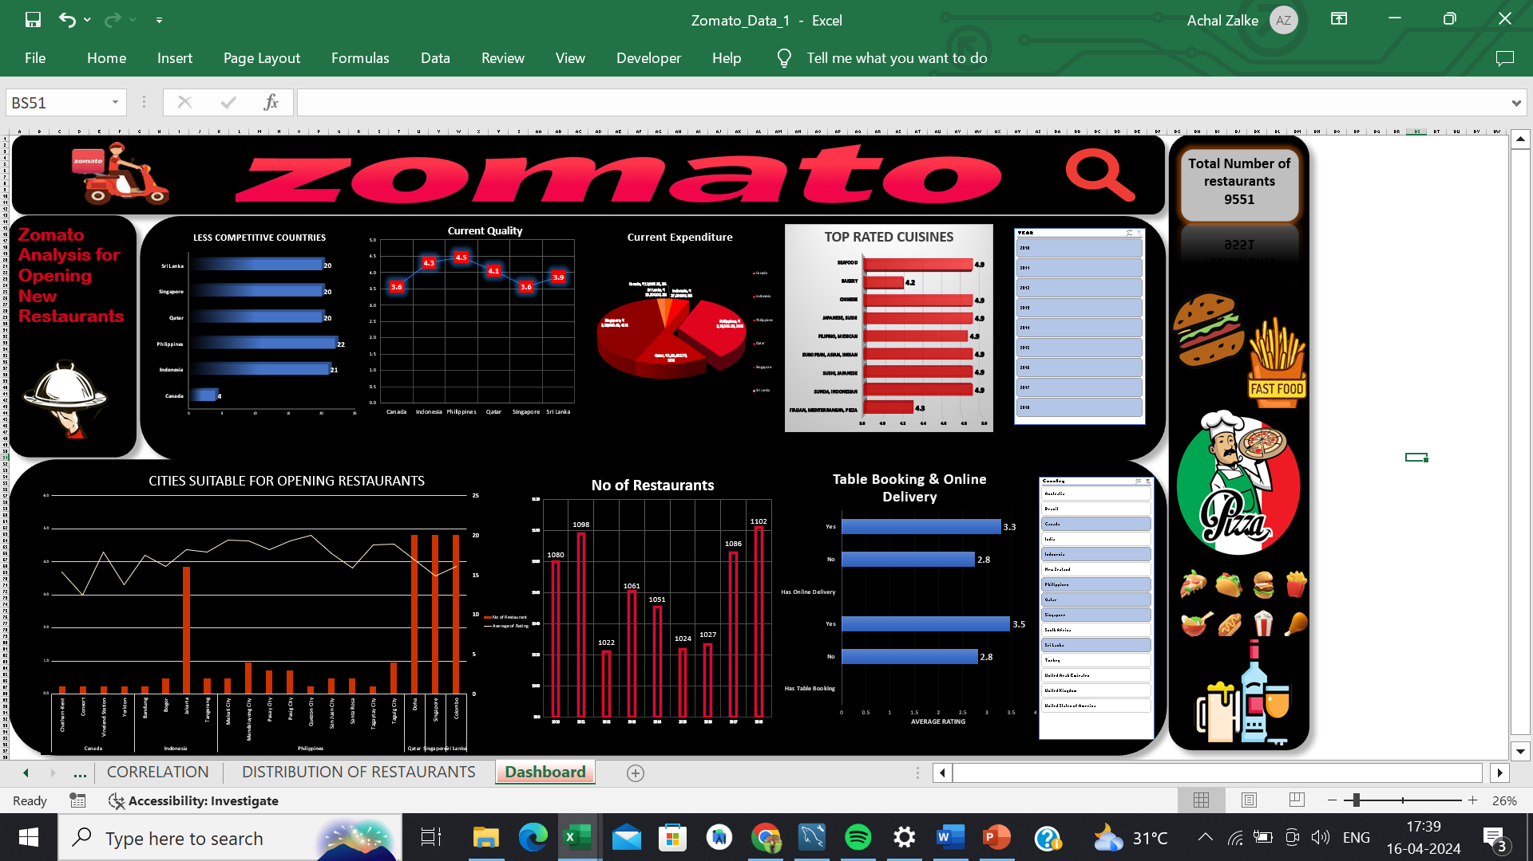
DASHBOARD

Slide 16
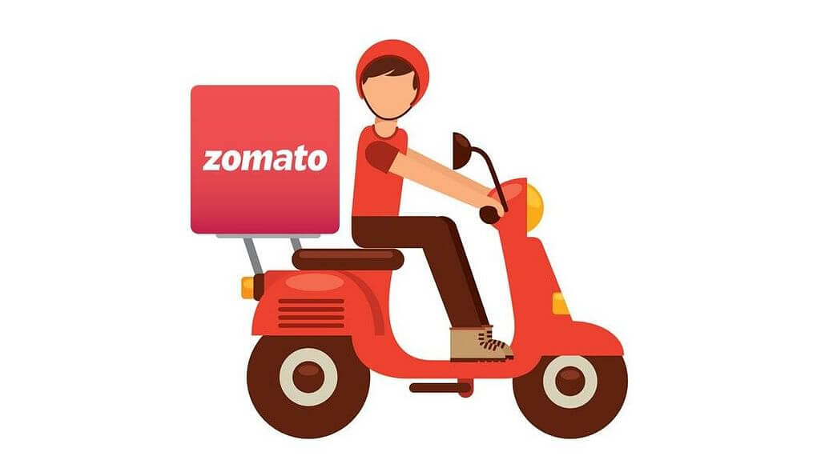
Through the dashboard we can identify the countries where we can open new restaurants.
Able to identify the cities where no. of restaurants are less so we can open there.
We can know the current quality of food which will help us.
Able to know the current expenditure which will help us to keep our financial expenditure in control.
Help us to understand that we should have table booking and online delivery which can increase our rating.
We have also used countries and year slicer to make the dashboard more interactive.

Slide 17

We should open our restaurants in countries that have less number of restaurants.
We should open restaurants where the number of restaurants is less and the rating is also less.
We should keep our expenditure less to keep our to keep track of our financial expenditure.
Restaurants must include top-rated cuisines.
Restaurants must-have table booking and online delivery which help increase the rating.
Our comprehensive analysis of Zomato's data paves the way for strategic initiatives that can drive further growth. enhance restaurants and customer satisfaction, and streamline operations. These insights help to make our place top at the business market

Slide 18

References
From Wikipedia
From Analytics Vidhya
From ResearchGate

Slide 19


